Slide 1
Edge Detection
The purpose of Edge Detection is to find jumps in the brightness function (of an image) and mark them.

Slide 2
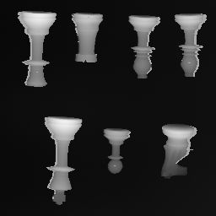
Consider this picture

Slide 3
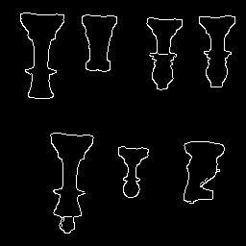
We would like its output to be

Slide 4
Concepts: Review
Weighted sum
Convolution
Gradients
Vector (of gradients)
Magnitude of a vector (of gradients)

Slide 5
Algorithms for edge detection: Review
Algorithm 1:
Compute gradients
Compute magnitude
Threshold magnitude
Smoothing, followed by Algorithm 1
ie, the Sobel edge detector
The association property of convolutions

Slide 6
Smoothing: Review
[ ]
[ ]
¼ ¼
¼ ¼
1 1
1 1
Can also be written as:
1/4
Meaning now, to get the complete answer, we should
compute:
( )
[ ]
[ ]
[ ]
1 1
1 1
-1 +1
-1 +1
Image
*
*
1/4

Slide 7
Association of convolutions: Review
( )
[ ]
[ ]
[ ]
1 1
1 1
-1 +1
-1 +1
1/4
Image
*
*
By the associative property of convolution we get this next step.
[ ]
[ ]
( )
[ ]
1 1
1 1
-1 +1
-1 +1
1/4
Image
*
*
We do this to call the convolution code only once, which precomputes
The quantities in the parentheses.

Slide 8
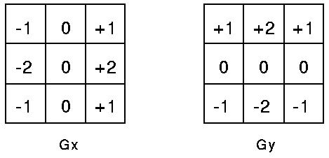

Sobel edge detector: Review
First these two masks are applied to the image.
The magnitude of the gradient is then calculated
using the formula which we have seen before:
Then, the two output tables of the masks and image are combined using the magnitude formula. This gives us a smoothened gradient magnitude output.

Slide 9
Smoothing is key: Review
[ ]
[ ]
¼ ¼
¼ ¼
1 1
1 1
Can also be written as:
1/4
Meaning now, to get the complete answer, we should
compute:
( )
[ ]
[ ]
[ ]
1 1
1 1
-1 +1
-1 +1
Image
*
*
1/4

Slide 10
Canny Algorithm
Part One
Convolve with Gaussian instead of four 1’s
Four 1’s is hat or box function, so preserves some kinks due to corners
When convolving, if the picture is the table on the left, then the table
on the right can be viewed as a Filter. i.e., the resulting output is going to
be whatever parts of the picture (table on the left) are to be emphasized.
Thus, table on the right is like a guard, permitting only certain parts of the
input to pass through to the resulting output.

Slide 11
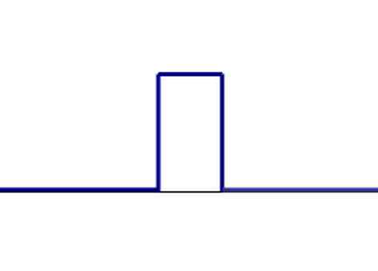
Canny Algorithm
Part One
Four 1’s is hat or box function, so preserves some kinks due to corners

Slide 12
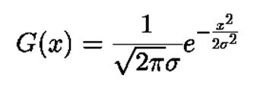
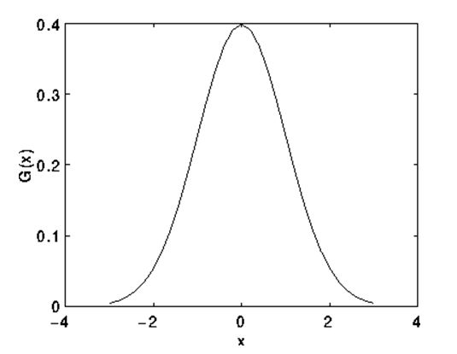
Canny Algorithm, Part One
Gaussian
The bell curve of the Guassian function makes
it ideal to smoothen an image, with out having
kinks in the output.

Slide 13


Canny Algorithm, Part One
Using Gaussian
Instead of convolving with +1|-1 for derivative, take derivative of Gaussian
This is the derivative of a one dimensional function. For an image, we will need to use a two dimensional function.

Slide 14
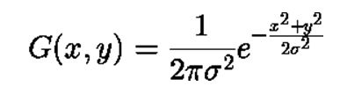
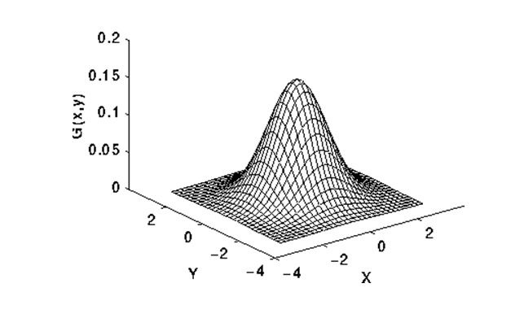
Canny Algorithm, Part One
2-d Gaussian
Take the derivative of this function and use it in our program. Plug in values for x, y, and sigma, to give us a table of weights.

Slide 15
Canny Algorithm, Part One
For derivative, should we convolve Gaussian table with a table of +1/-1’s (as Sobel did) or should we use a formula that has already taken the derivative of the Gaussian? In both cases, we would have to generate a table from a formula. In the first option, the table would be generated from the Gaussian formula, and in the second option, the table would be generated from the (Gaussian’s) derivative equation.
It turns out that the second option is better, if the intent is to increase accuracy.
In either case, we would need to figure out how large our table should be.
We will discuss this size calculation in the context of the first option, but the
reasoning will carry over to the second option as well.

Slide 16
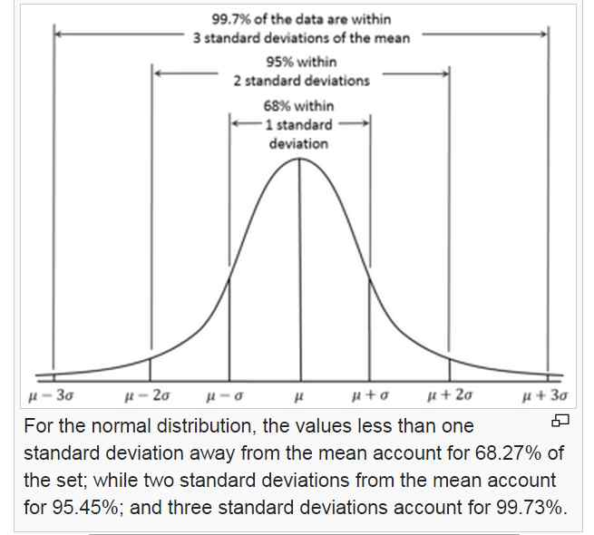
Canny Algorithm, Part One
Using Gaussian, how wide will it be?
We start this size calculation, by noticing this:

Slide 17
Canny Algorithm, Part One
This figure is from Wikipedia
We notice that the Gaussian function has very small values to the left of the
third negative Standard Deviation, and the same behavior to the right of the
third positive Standard Deviation. Hence, we only need to represent the
Gaussian within this window, from negative third SD to positive third SD.
Outside of this window, the values of the function are tiny, and hence
negligible, and so we choose to crop the function at these ends.

Slide 18
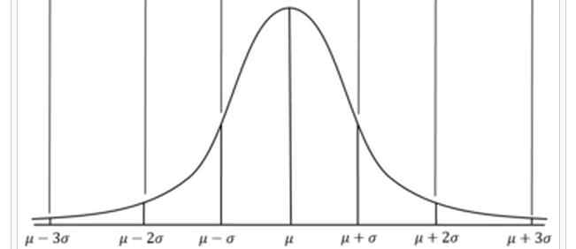
Canny Algorithm, Part One
How wide to represent the Gaussian?
O O O O O O O
So, we will sample our Gaussian at the location of these circles. In general,
Our Gaussian will be represented at one position for the center, and (plus) however
many positions are needed to cover 3σ on each side of the center. A boss will
tell us how large σ needs to be, i.e., how wide the Gaussian is to be.

Slide 19
Canny Algorithm, Part One
Gaussian’s width:
The boss tells us how wide each sigma is to be.
So, if boss says σ is to be 1 pixel wide, then the total window will be
1 + 3*1 + 3*1, i.e., 7 pixels wide.
If boss says σ is to be 2, then window’s total width is
1 + 3*2 + 3*2, i.e., 13 pixels wide.
If σ is to be 3, then total width is 19. And so on. The basic idea is
that the width is give by: 1 + 3*σ + 3*σ.

Slide 20
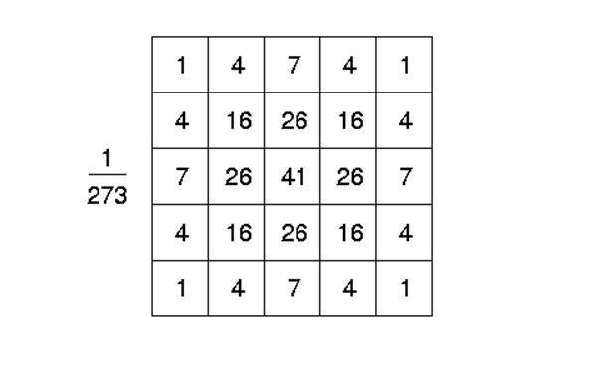
Canny Algorithm, Part One
Using Gaussian
We can use either a table of weights, or we can use an equation within the code to
Increase accuracy.

Slide 21
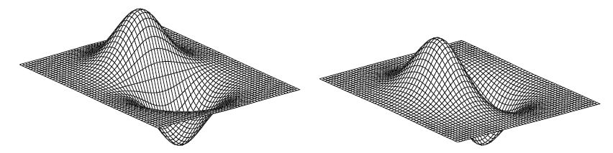
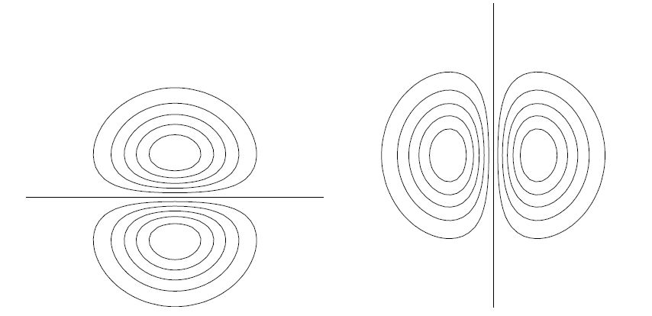
Canny Algorithm, Part One
2-d Gaussian, plus derivative
Instead of convolving with +1|-1 for derivative, take derivative of Gaussian

Slide 22
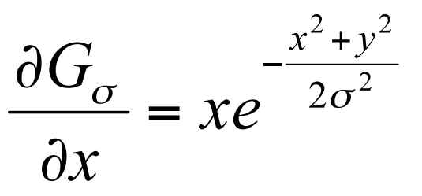
Canny Algorithm, Part One
2-d Gaussian, plus derivative
Instead of convolving with +1|-1 for derivative, take derivative of Gaussian

Slide 23
Canny Algorithm, Part One
So, the main difference between Canny Part One and Sobel is
the smoothener (Canny uses a Gaussian Sobel uses the four one’s.
To write code for canny, we will start with marrh.c and do these steps.
-- Marrh.c uses flexible size masks (which we need), we will keep
this part of the code.
-- Marrh.c uses second derivatives, whereas we need only first derivatives
(we need first x- and y- derivatives), so we will change the equation
in the marrh.c line to be the first x-derivative.
-- Then, because we need two derivatives, we will double up on that line,
i.e., make a copy of it to compute the y-derivative, finally ending
up with two masks (xmask and ymask).

Slide 24
Canny Algorithm, Part One
-- Then use the convolution code from marrh but remember to double up on it, to get two outputs.
-- Then delete the code in marrh that is below the convolution code.
-- Then bring in the sqrt (of squares) code from sobel. This will compute the
magnitude, will scale it for output, and will print it out.
-- At this point, you are done with Canny part One, and your code should
produce output very similar to the Sobel magnitude image.

Slide 25
Canny Algorithm, Part Two
Peak Finding, Non-Maxima Suppression
Consider four directions available in 3x3 neighborhood
Peak finding first determines edge direction, and then tests the pixels that are on the sides (perpendicular) to see if ithe center pixel has the highest value among said neighbors. If it has the highest value then it will be considered a potential edge. So, peaks are potential edges. If a pixel is not a peak, it has no chance of being an edge.

Slide 26
Canny Algorithm, Part Three
Double Threshholding, Hysteresis Thresholding
First, accept all peak pixels where Magnitude exceeds HIGH, then all who are
connected to HIGHs and also exceed a lower LO threshold.
Often times in edge detection, there will be edges that will be very close to the threshold. This causes noise and dotted edges. Using double thresholding, we can eliminate that noise by having two thresholds, a high and a low. An edge must first exceed the higher threshold. Any peak pixel touching a valid edge must have a value less than the low threshold to not be considered an edge. Conversely, any peak pixel must at least exceed the low threshold for a valid edge neighbor to bring the peak into the final edge.

Slide 27
Canny Algorithm, Part Four
Automatically, determine HI and LO.

